Slide 1
Advanced Steels in Vehicle Construction
Mike Smith
BoronExtrication.com

Slide 2
Why are vehicles getting stronger body structures?
Weight reductions improve fuel economy
New federal safety standards

Slide 3
Federal Motor Vehicle Safety Standards
FMVSS 214 Side Impact Protection
FMVSS 216 Roof Crush Resistance
FMVSS 226 Occupant Ejection Mitigation

Slide 4
Federal Motor Vehicle Safety Standard (FMVSS) 214
The phase-in began on September 1, 2009 and September 1, 2012, all vehicles must meet the upgraded pole and barrier test requirements of the standard
Notes:
Federal Motor Vehicle Safety Standard (FMVSS) 202 was recently revised to require higher head restraints that lie closer to occupants' heads.

Slide 5
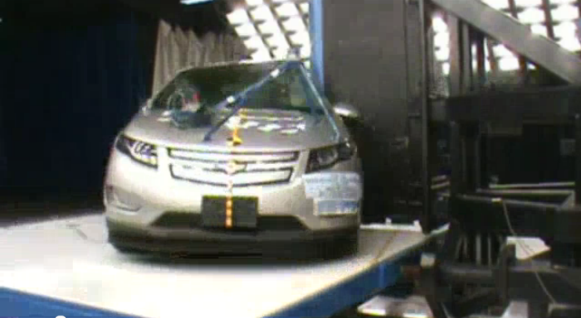
Federal Motor Vehicle Safety Standard (FMVSS) 214

Slide 6
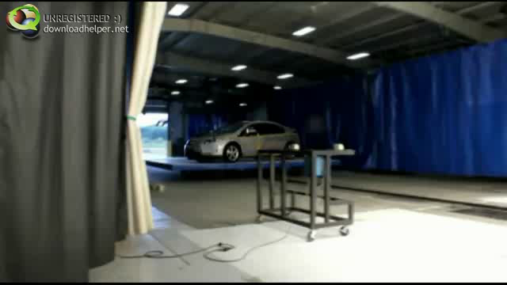
2011 Chevy Volt FMVSS 214

Slide 7
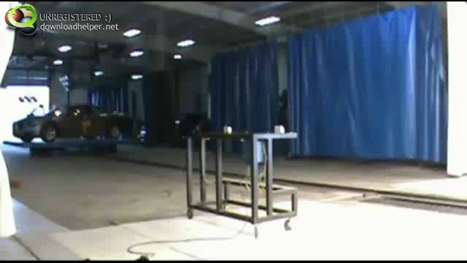
2011 Dodge FMVSS

Slide 8
Federal Motor Vehicle Safety Standard FMVSS 216
Establishes a minimum requirement for roof strength.
In this test, a rigid plate is pushed into one side of the roof at a constant speed. The roof must be strong enough to prevent the plate from moving 5 inches when pushed at a force equal to 1½ times the weight of the vehicle.
The test went into effect in 1973 and remained essentially unchanged until an updated rule was announced in 2009.
The new rule will require that a roof withstand an applied force equal to 3 times the vehicle's weight while maintaining sufficient headroom for an average size adult male.

Slide 9
Federal Motor Vehicle Safety Standard FMVSS 216
The new standard will be phased in beginning with 2013 model vehicles, and by the 2017 model year, 100 percent of each manufacturer's fleet must comply.
The updated FMVSS 216 will regulate the roof strength of many SUVs and pickup trucks by extending coverage to vehicles with gross weight ratings (GVWRs) up to 10,000 pounds.
In the past, the standard applied only to vehicles with GVWRs up to 6,000 pounds, which meant about 44 percent of the SUV and pickup fleets were exempt.
While roof strength regulation now applies to these vehicles, they are not subject to the same force requirements. Instead of a force equal to 3 times the vehicle's weight, vehicles with GVWRs over 6,000 pounds are subject to a force equal to 1½ times their weight.

Slide 10
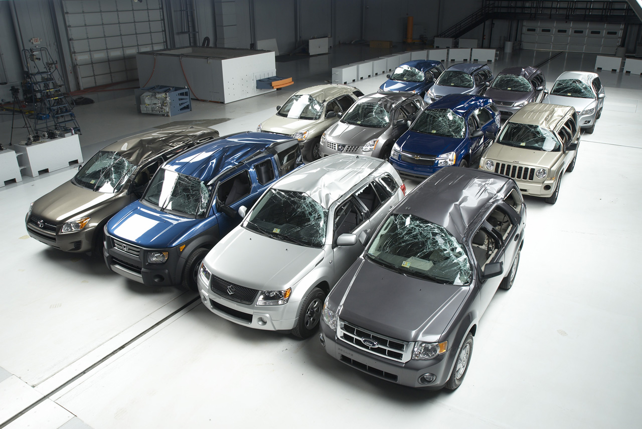
Roof Crush Resistance FMVSS 216

Slide 11
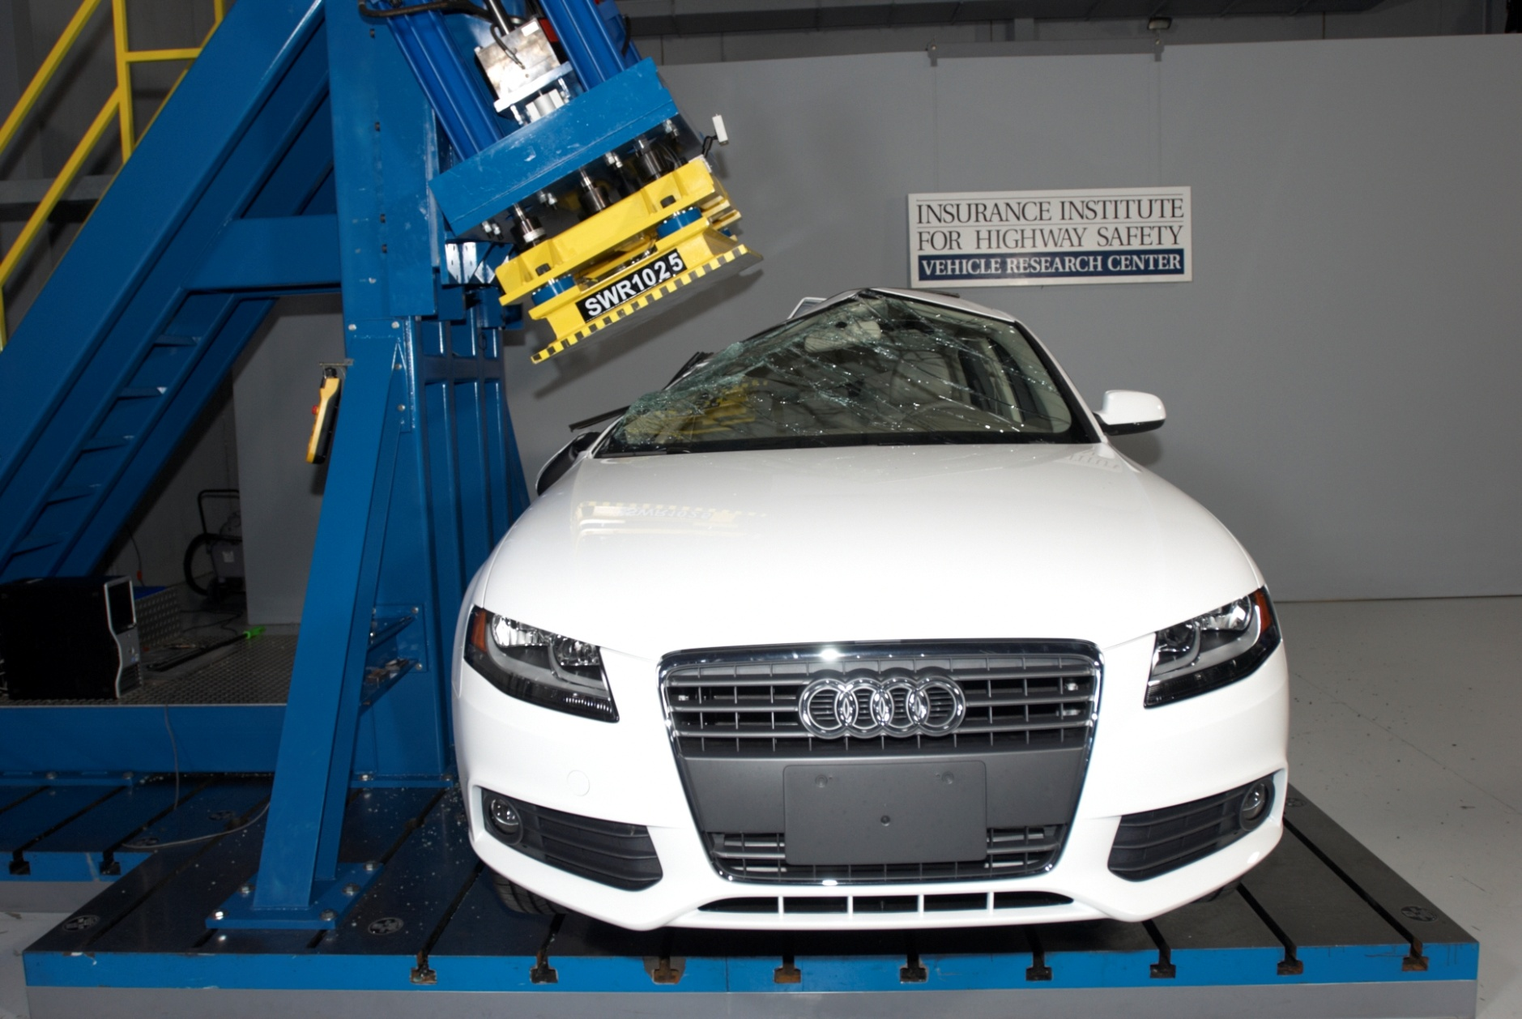
Roof Crush IIHS Test
Notes:
2010 Audi A4 rollover roof strength test after

Slide 12
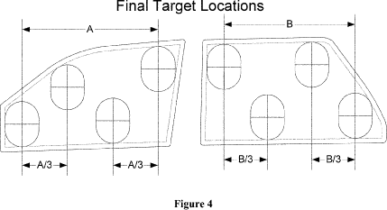
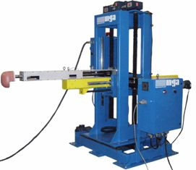
Occupant Ejection Mitigation FMVSS 226

Slide 13
Advanced high-strength steels
Advanced high-strength steels (AHSS) require less energy and emissions to produce than other automotive structural material, make lighter parts that reduce vehicle weight and increase fuel economy, and are fully recyclable.

Slide 14
Advanced high-strength steels
These new steels benefit the vehicle in three vital areas of a vehicle’s life: manufacturing, driving, and end-of-life recycling. Consequently, they are the fastest-growing material in new vehicles today.
The use of AHSS reduces a vehicle’s structural weight by as much as 25 percent and can cut total life cycle CO₂ emissions by up to 15 percent more than any other automotive material.
Because it is fully recyclable, steel used in today’s cars can help automakers reduce the carbon footprint of tomorrow’s vehicles, as well.
Automobiles are recycled more than any other product, with nearly 100 percent of vehicles recycled today for their iron and steel content, In 2008, this resulted in more than 14.8 million tons of steel recovered for re-use from scrapped automobiles

Slide 15


Slide 16
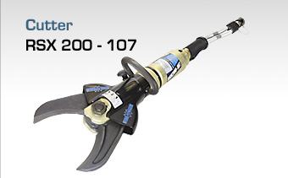
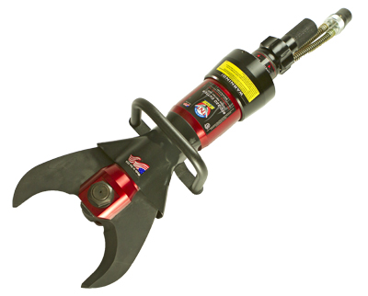
Hydraulic Cutters
Weber Rescue RSX200-107
Cutting force:
239,680 foot pounds
107 ton pounds
TNT BFC-320
Cutting force:
320,000 foot pounds
143 ton pounds

Slide 17
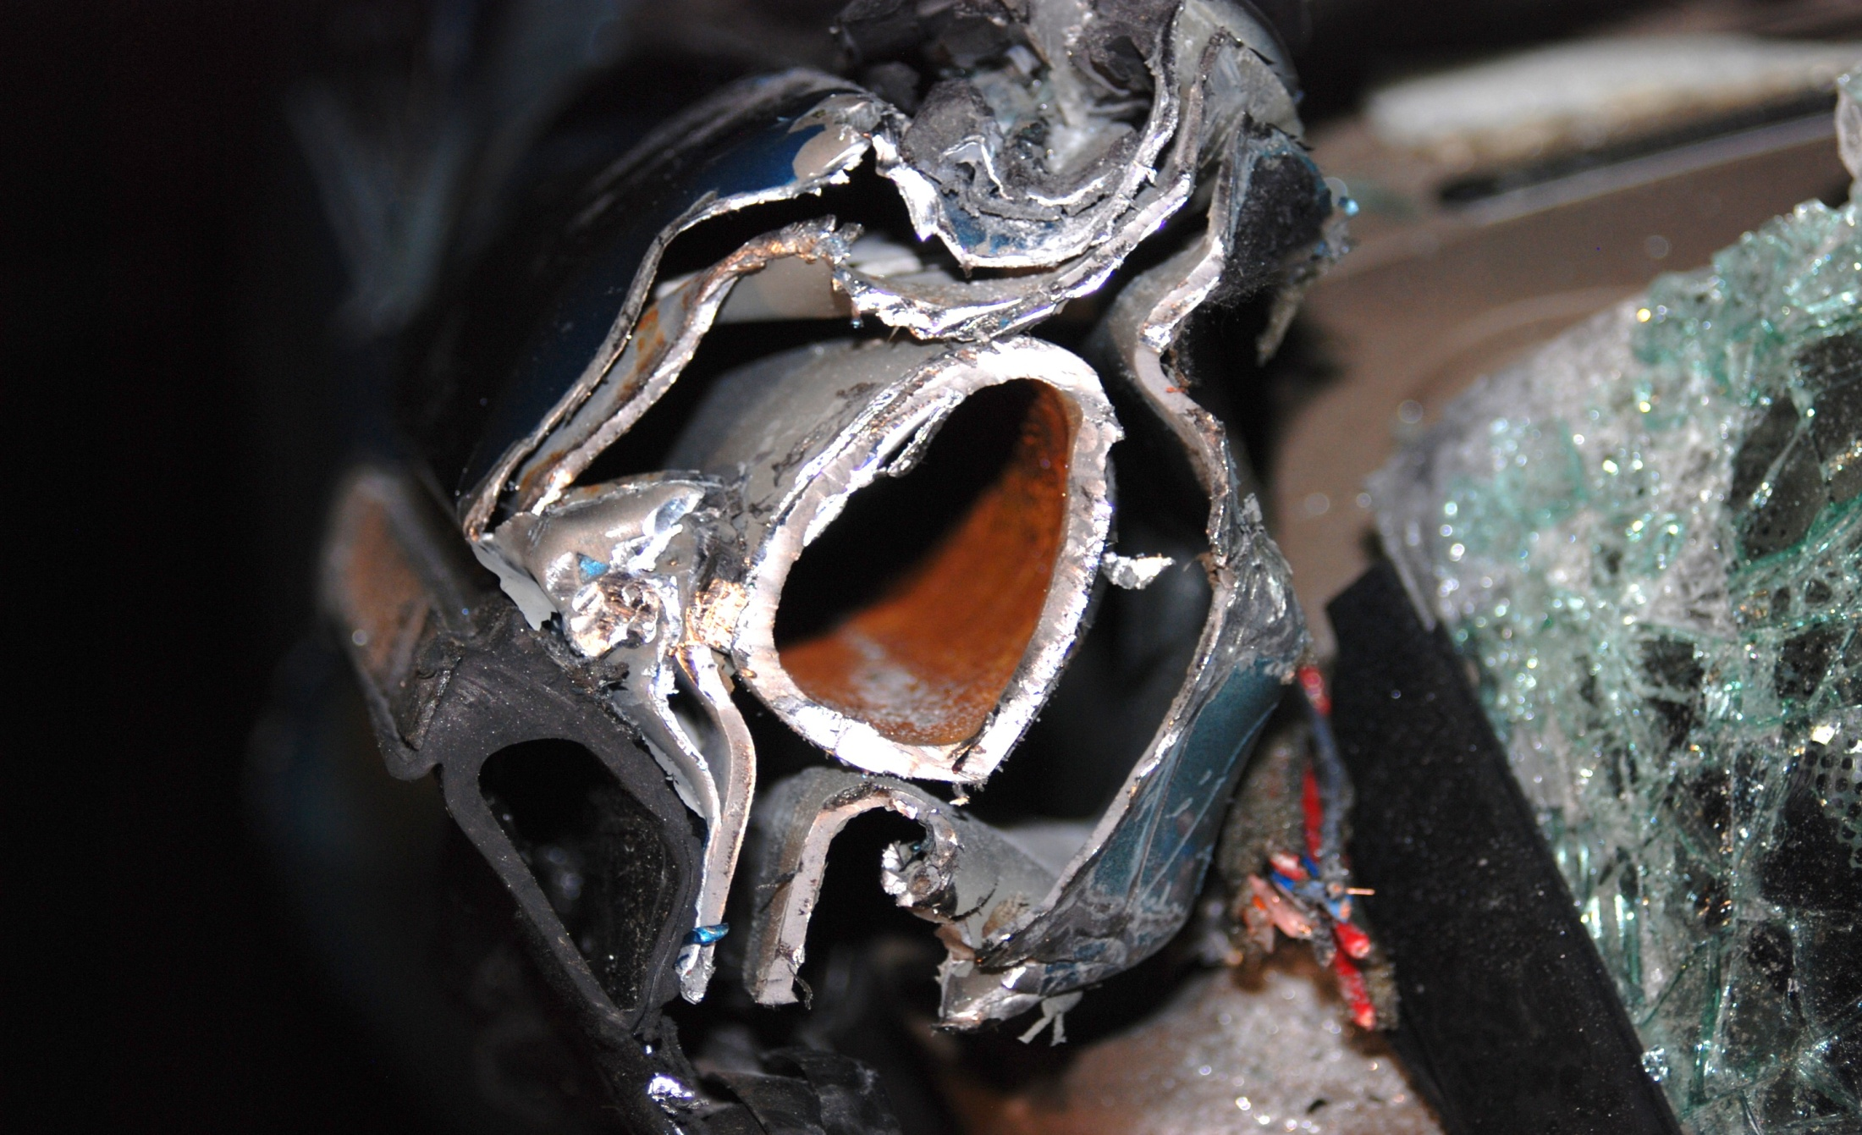
A-Pillar

Slide 18
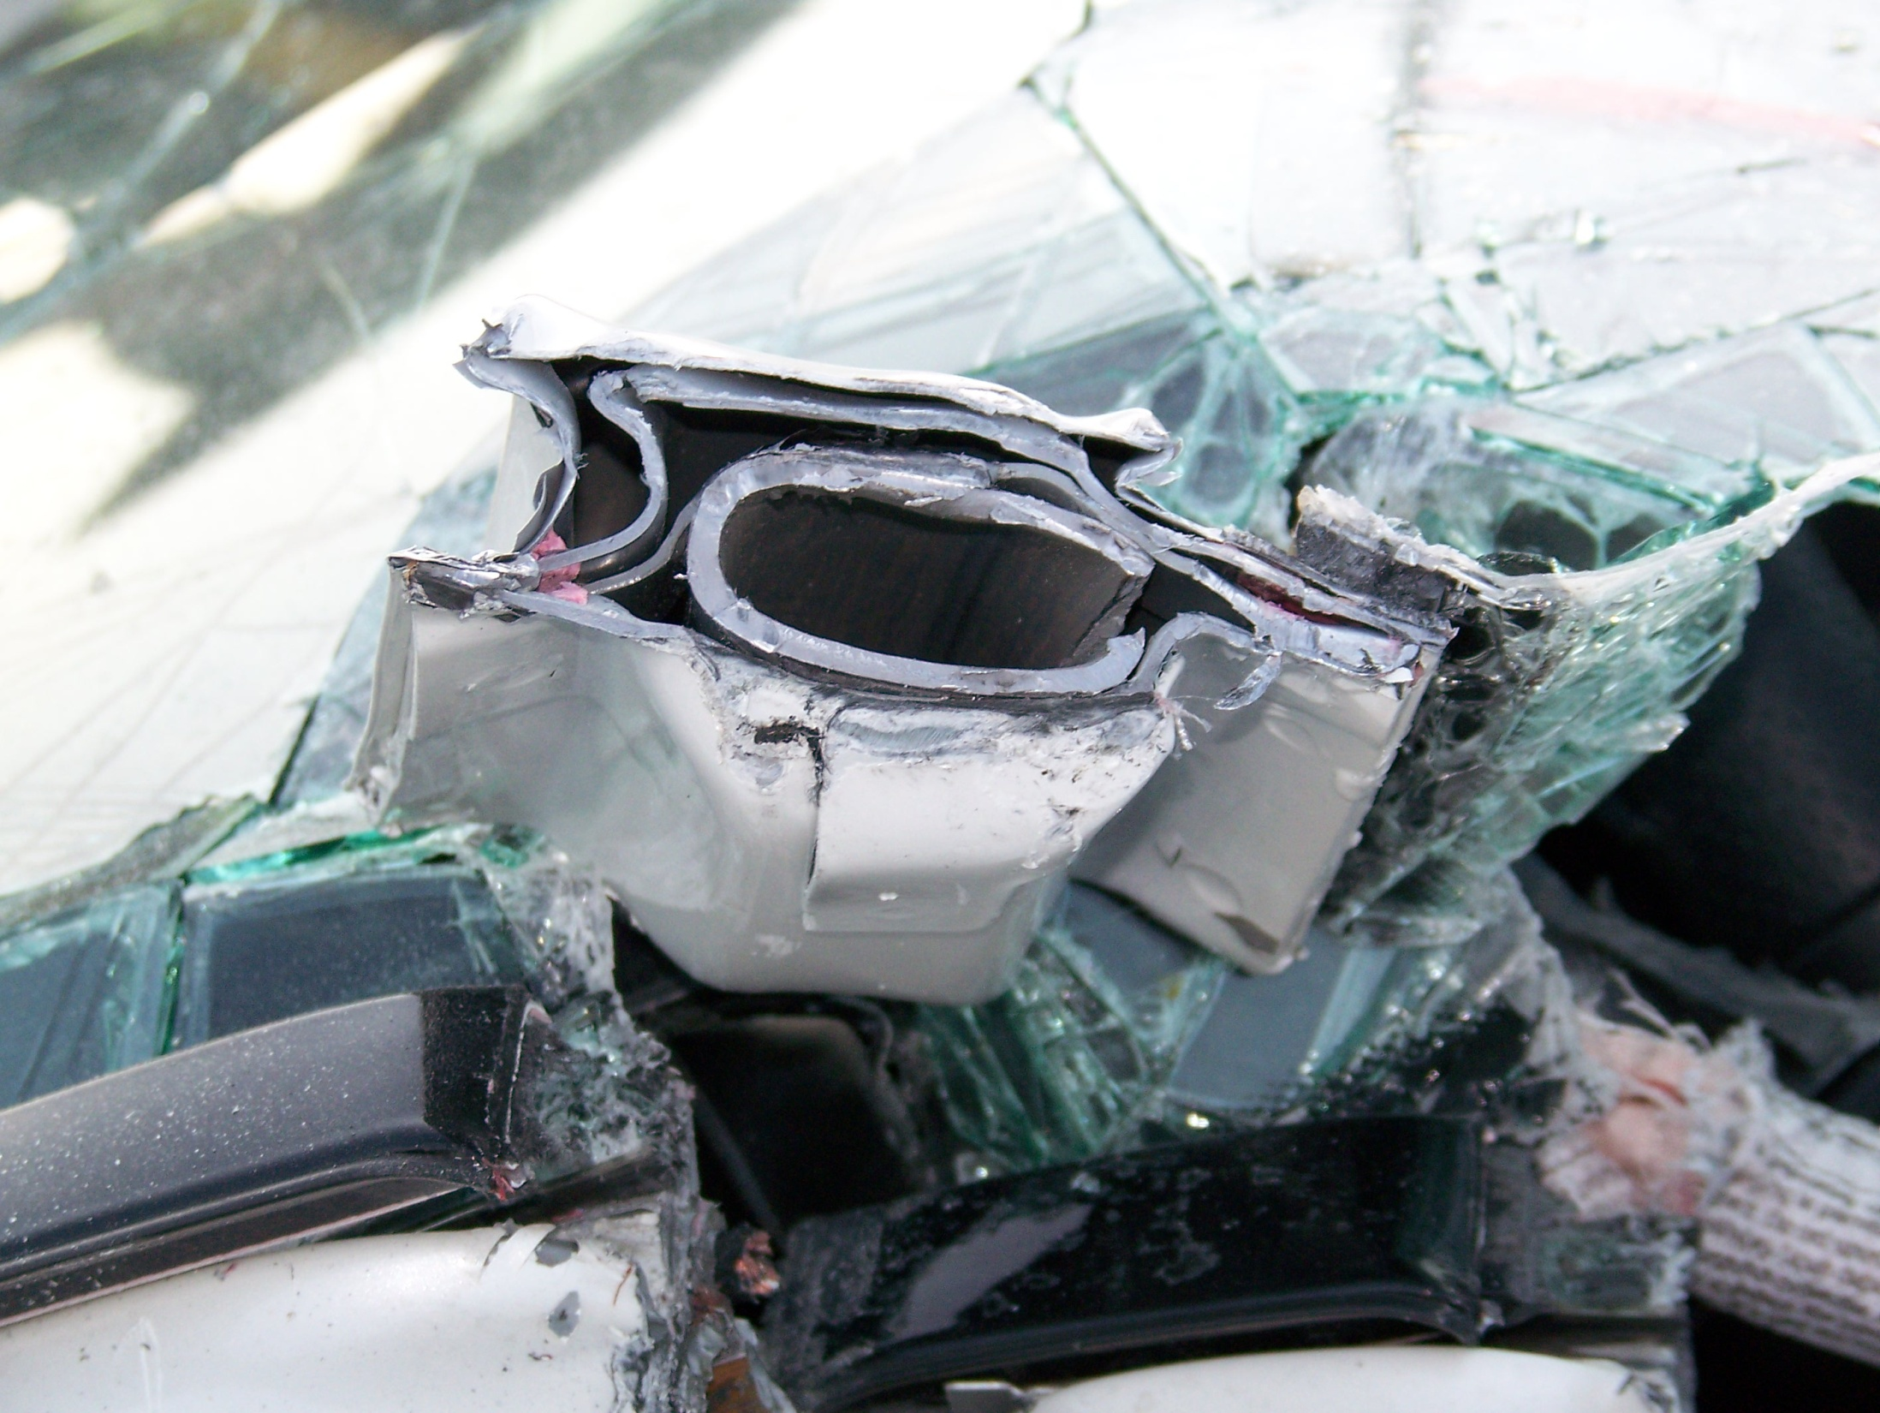
2011 Mercedes A-Pillar

Slide 19
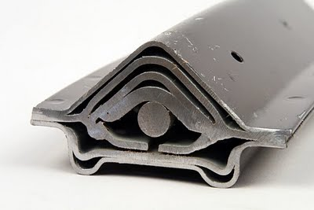
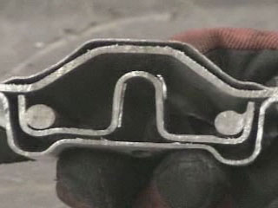
B-Pillar
2000 Subaru Legacy
2004 Subaru WRX

Slide 20
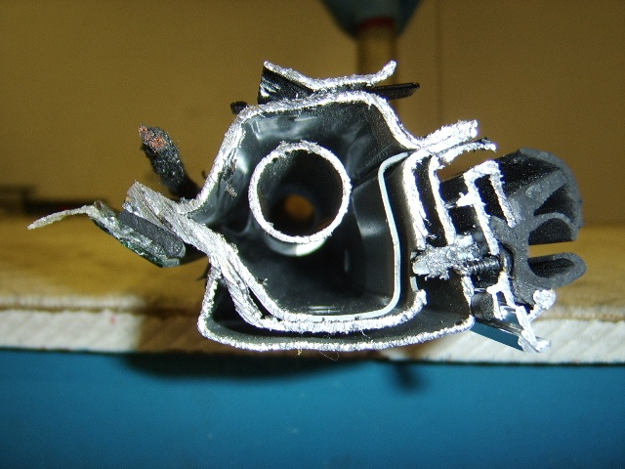
B-Pillar Reinforcements
Notes:
Mercedes Benz is using a boron alloyed steel tube inside the A-Post for added strength and flexibility on the CLK series.

Slide 21
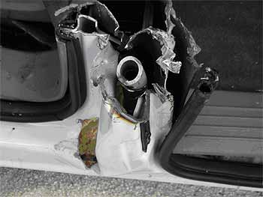
B-Pillar Reinforcements
Notes:
Chrysler is also using an ultra high strength steel pipe inside their B-Post on their mini-vans.

Slide 22
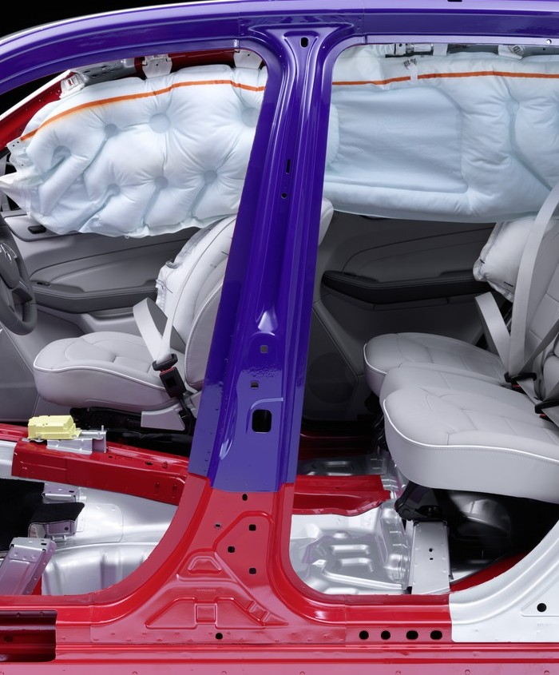
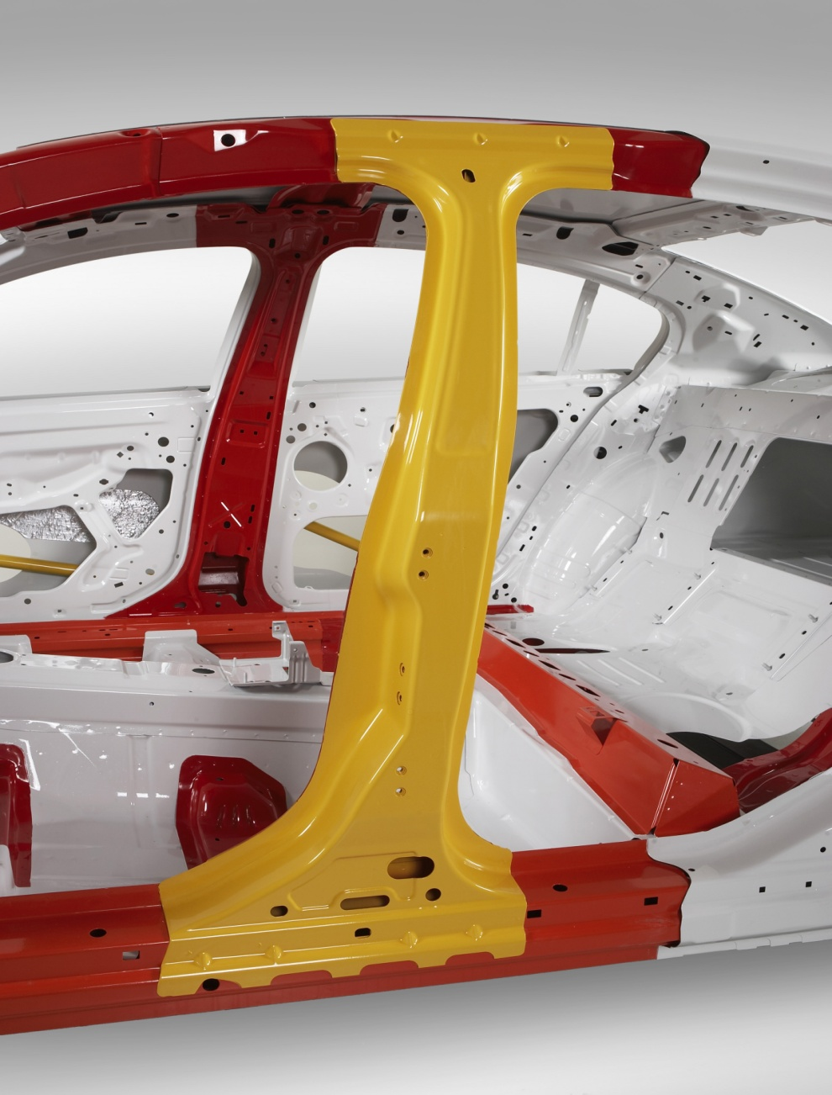
B-Pillar Shapes

Slide 23
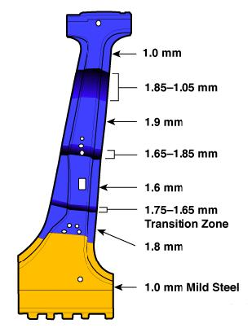
B-Pillar Thickness
Penny – 1.55MM
Dime - 1.35MM
Nickel - 1.95MM
Quarter -1.75MM
Dollar - 2.0MM
Notes:
2007 Dodge Caliber has Ultra-High Strength Steel UHSS in the A-pillar, B-pillar, and roof-rail reinforcements. The B-pillar is made from a tailor-rolled, hot stamped steel.

Slide 24
Know where to cut
Never stop trying to cut. Tailored Blanks are very common with Boron and UHSS.
Some Pillars even have Mild Steel mixed in with the Boron and UHSS

Slide 25
Symmetrical Design
Automotive designers and engineers often mirror parts from the driver side to the passenger side.

Slide 26
Sounds While Cutting Advanced Steel
Listen for a “Pop”
Almost sounds like breaking glass
Boron is fractured during a cut
Away have situational awareness because parts can shoot off the vehicle.

Slide 27
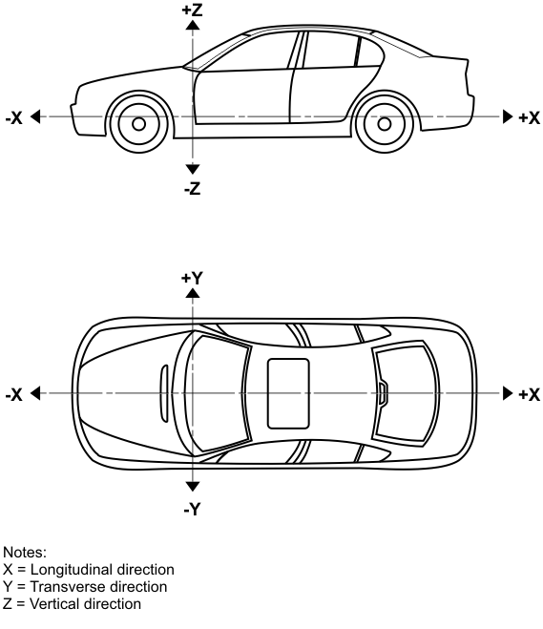

Slide 28
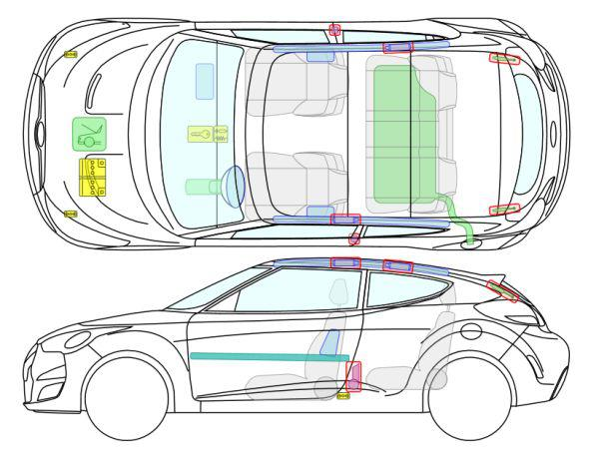
2012 Hyundai Veolster

Slide 29
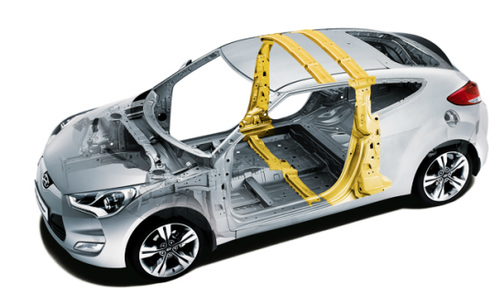
2012 Hyundai Veolster

Slide 30
Common Parts
Automakers use common parts across many different vehicle lines and different area in the vehicle.
A common part is not like a mirrored part.

Slide 31
Questions?

