Slide 1
Advanced Steel Manufacturing and Stamping
Mike Smith
BoronExtrication.com

Slide 2
Module Overview
Hot stamping advanced steels
What are tailored blanks?
Where are tailored blanks used?

Slide 3
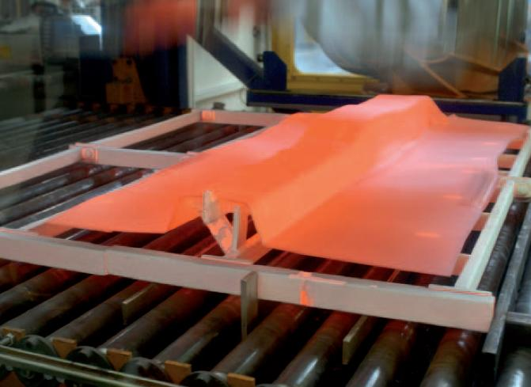
Hot Stamping

Slide 4
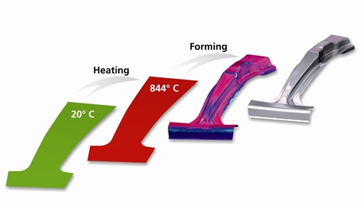
Hot Forming of a B-pillar
Notes:
Hot forming processes have recently become important for the automotive industry to meet specific requirements regarding a higher level of crash safety and a reduction of overall weight. Many automotive manufacturers use these processes to produce body structure components such as A and B-pillars, tunnels, front and rear bumper beams, door sills, door beams, side-rail parts, roof rails and roof frames. These components have the highest requirements regarding strength. The use of high strength steels in conventional stamping processes is difficult due to their reduced formability and strong tendency to springback. Hot forming technology can be used in order to overcome these limitations. Components are stamped in the soft stage at elevated temperatures and quenched after forming to achieve a martensitic structure resulting in a very high strength of 1500 MPa.
Hot forming is a temperature and time dependent process and therefore its simulation is obviously more complex compared to conventional stamping processes. AutoFormplus R1 has been enhanced to include thermo-mechanical processes, making it possible to simulate hot forming.

Slide 5
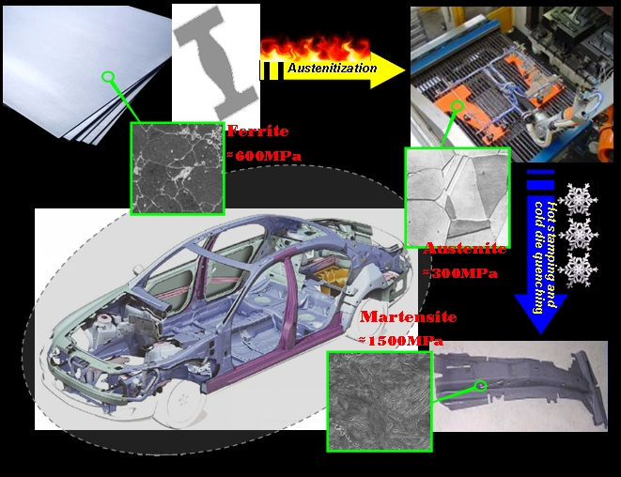
Hot Stamping of Boron Steel

Slide 6
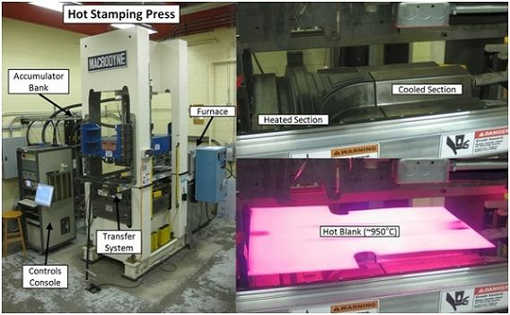

Slide 7
Tailored Blank
A tailored blank is a sheet of steel that combines several grades and / or various thicknesses and / or different coatings, the different parts being laser welded together, in order to place the best material at the best place in the right thickness for a real “tailor-made” solution for the customer after stamping.

Slide 8
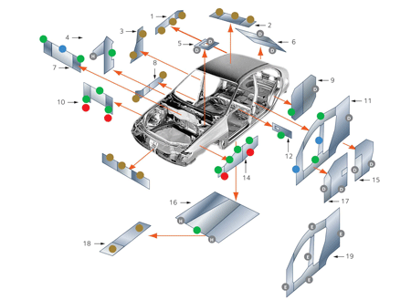
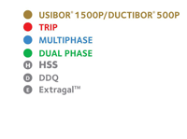
Vehicle Applications
1. Rear Rails
2. Roof Reinforcement
3. B-Pillar
4. A-Pillar
5. Shock Tower
6. Tailgate
7. Cross Member
8. Side Member
9. Wheel House
10. Engine cross member
11. Body side
12. Seat cross member
13. Bumper reinforcement
14. Front rail
15. Rear door
16. Floor panel
17. Front door
18. Tunnel reinforcement
19. Body side outer

Slide 9
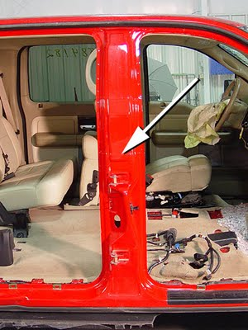
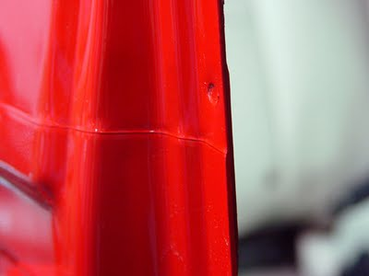
Laser Welded Tailor Blank

Slide 10
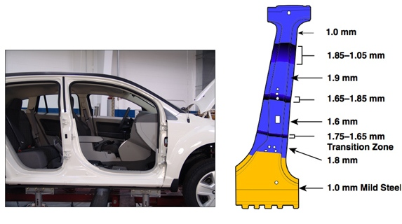
Tailor-Rolled Blank

Slide 11
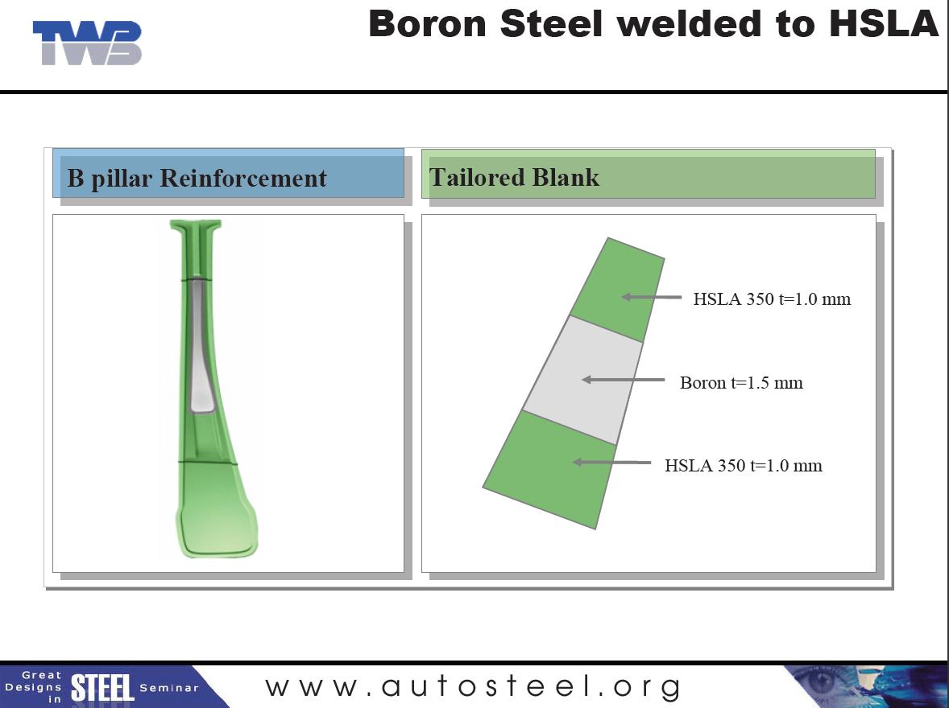

Slide 12
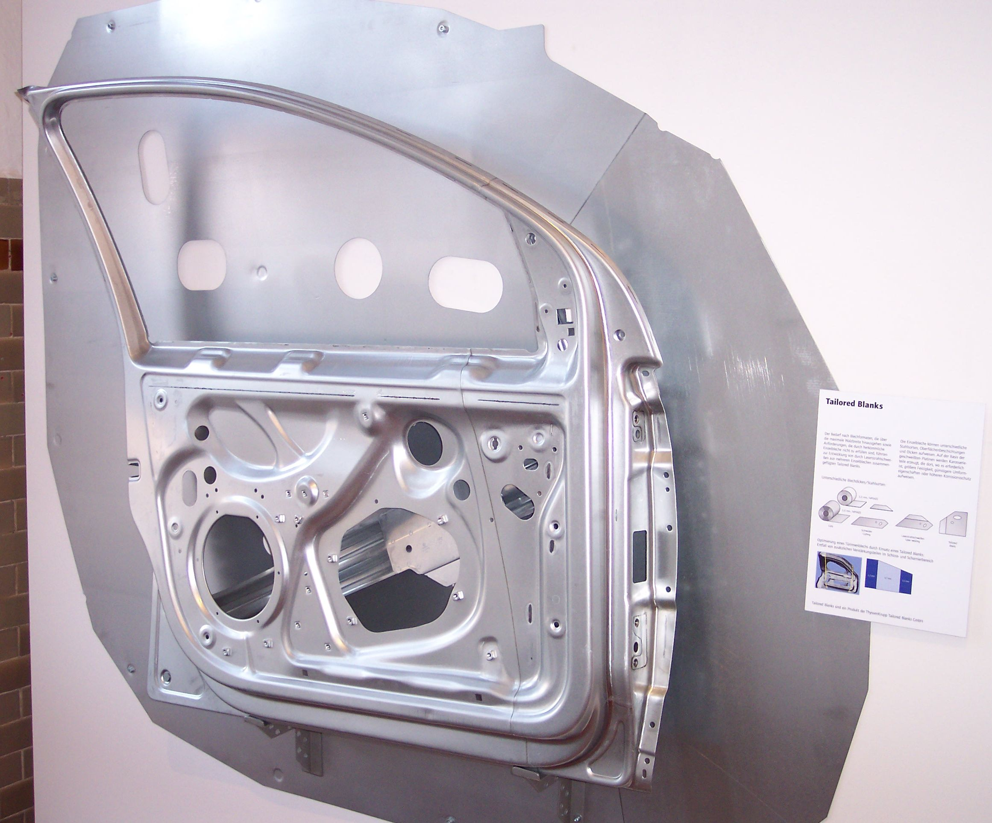

Slide 13
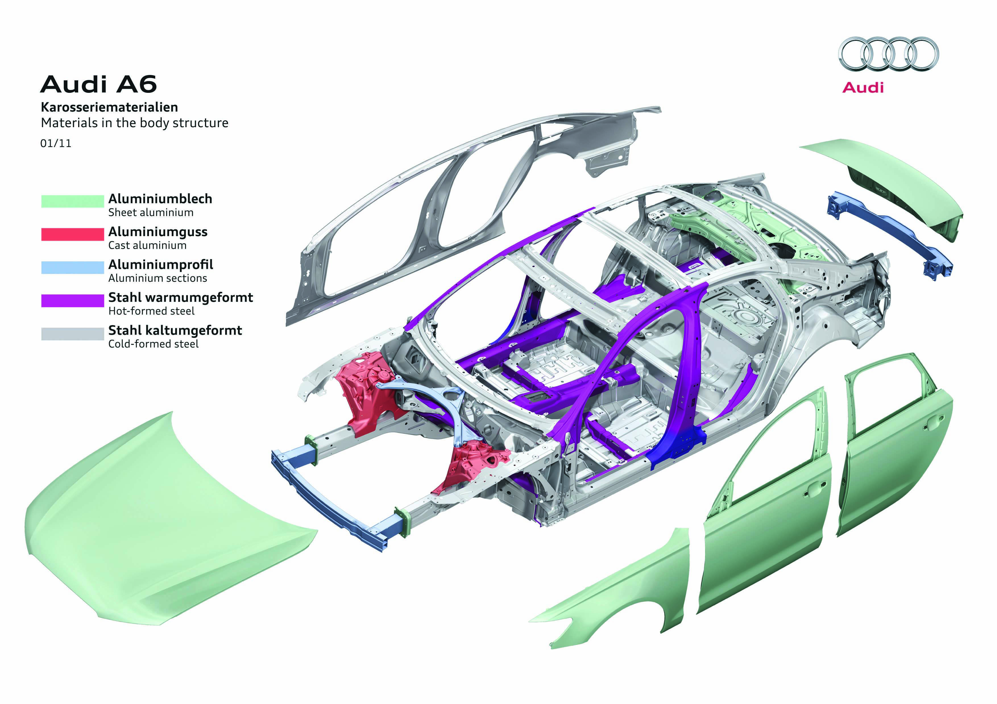
Audi A6 Body Structure

Slide 14
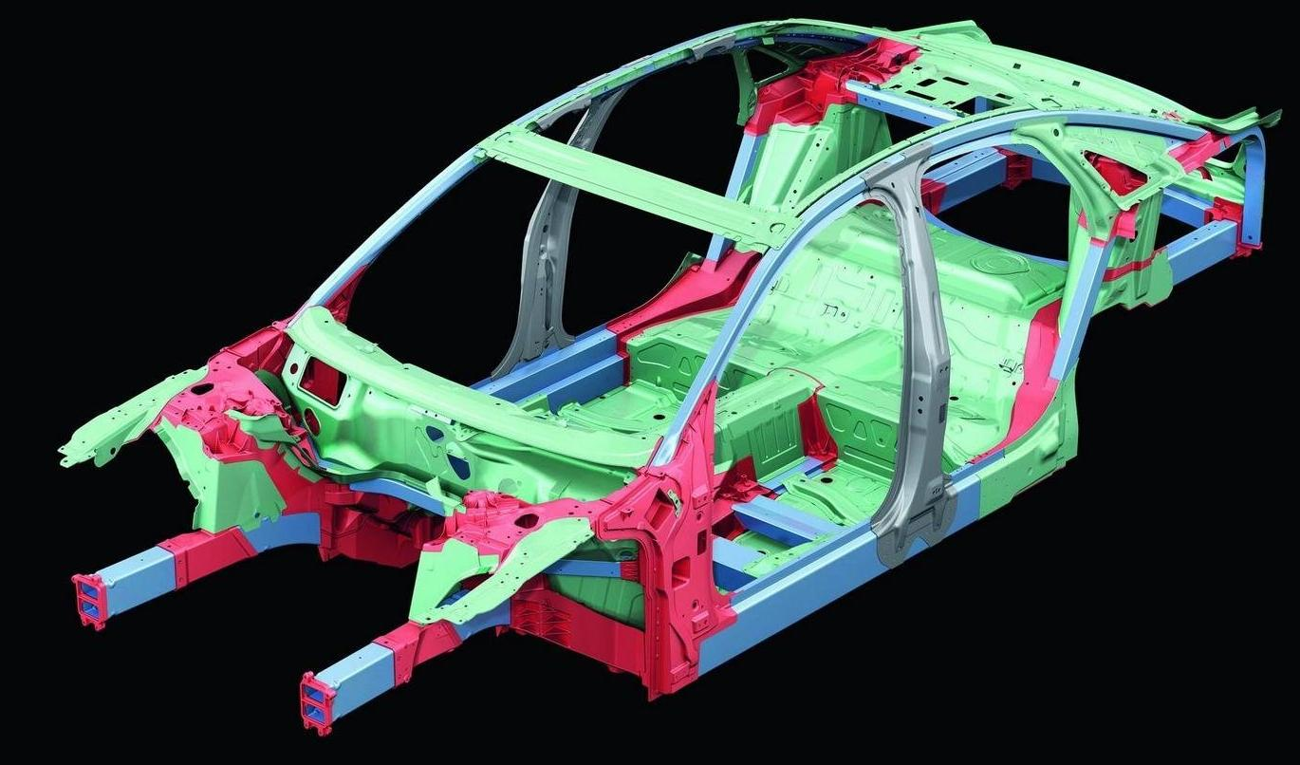
Audi

Slide 15
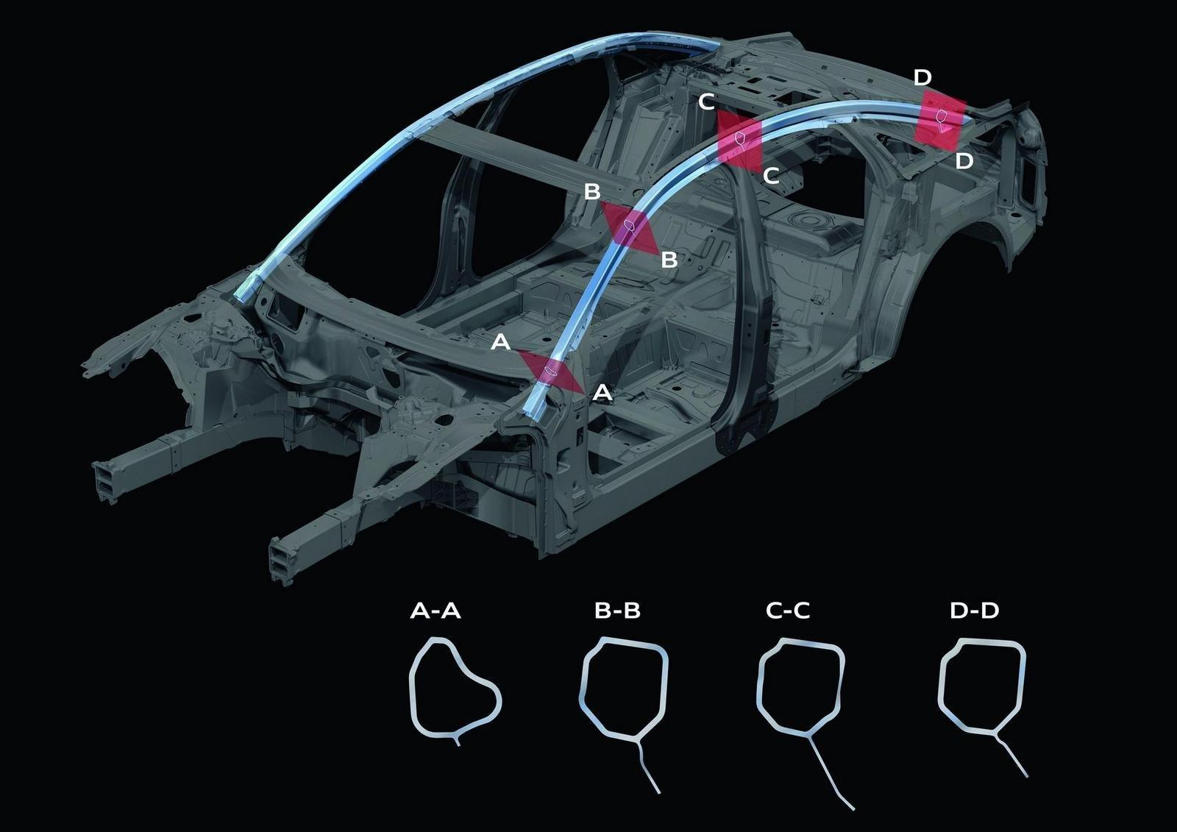
Notes:
2011 Audi A8 The 2011 Audi A8 is a very uniquely built vehicle. First off, the body is aluminum Audi Space Frame (ASF). Each part of the body structure of the Audi A8 is built depending on their tasks in the vehicle. The image below shows the lateral roof frame (light blue) is made with a single extruded section; its cross-section changes flexibly from the A-pillar to the C-pillar.

