Slide 1
Teaching Advanced Steels
Mike Smith
BoronExtrication.com

Slide 2
Module Goals
Methods to get newer vehicles
The vehicle rescue instructor/trainer will conduct effective training that simulates the presence of Advanced Steel in an older, acquired vehicle.
Simulate hydraulic tool failure, broken blade, cutter stalls during a cutting operation, etc.

Slide 3
Getting Late Model Vehicles
Large automotive insurance companies
Automotive manufactures
Large junk yards and recycling yards
Local towing companies

Slide 4

Vehicles we want to cut

Slide 5
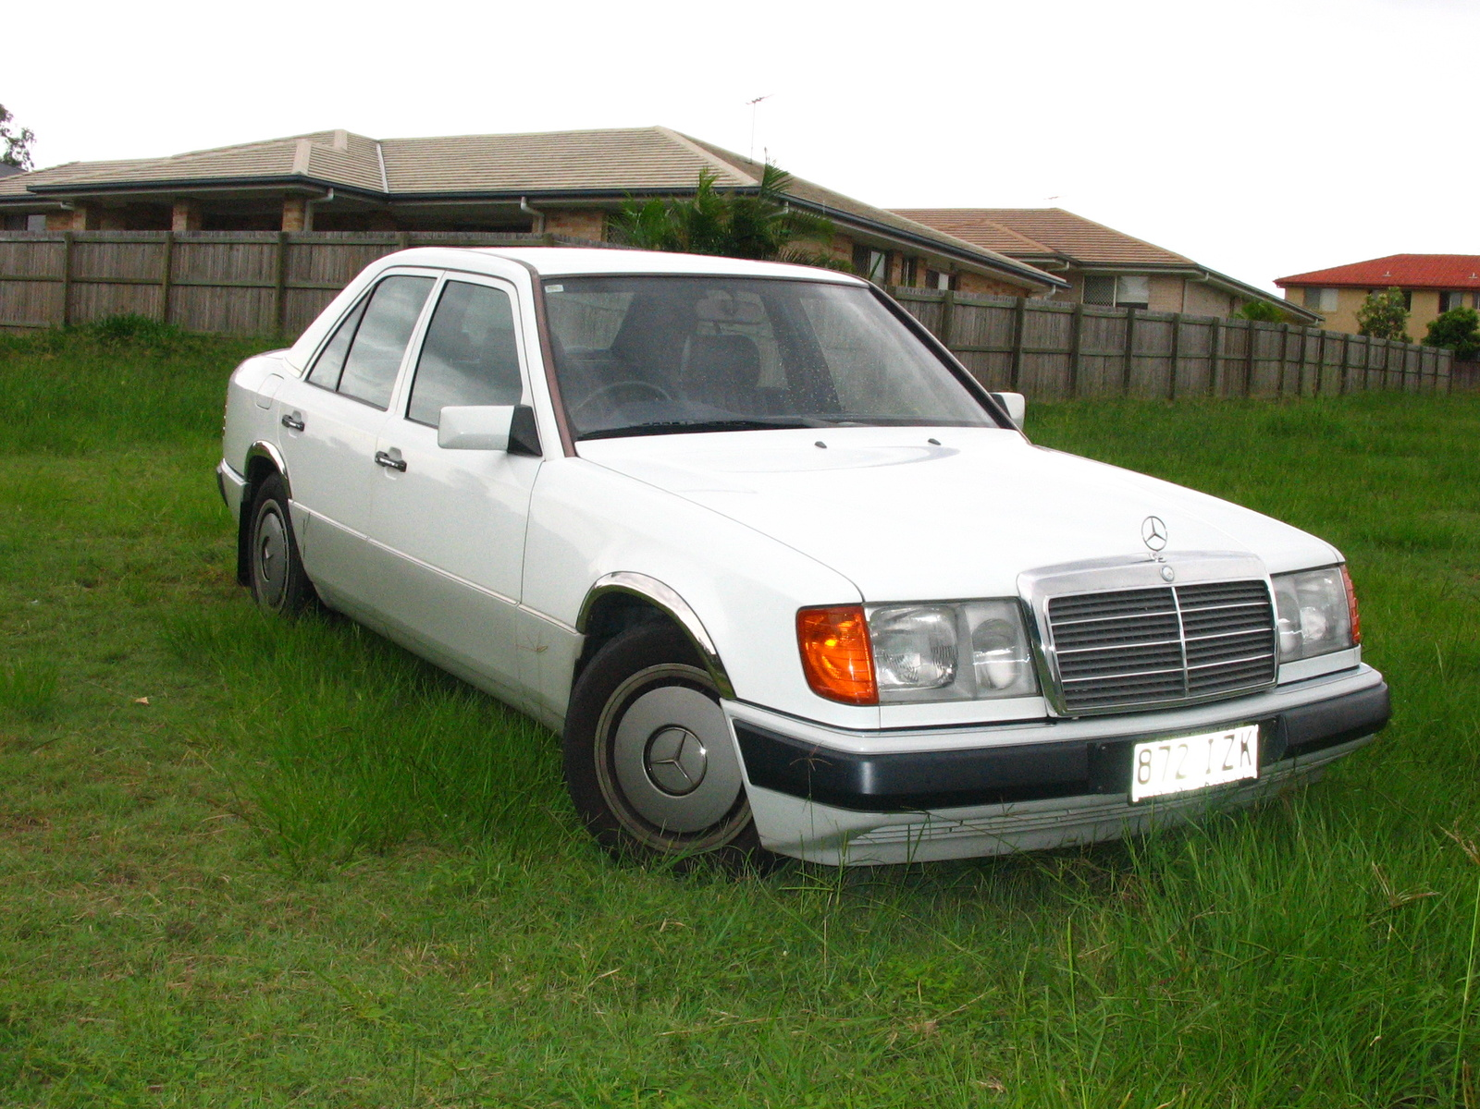
Want we end up with

Slide 6
Simulate the Presence of Advanced Steels
So how do you do that on a that 20 year old car that the tow yard dropped off on the training grounds?
Easy! Spray Paint!

Slide 7
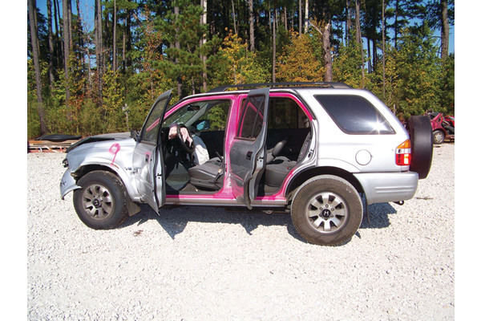

Slide 8
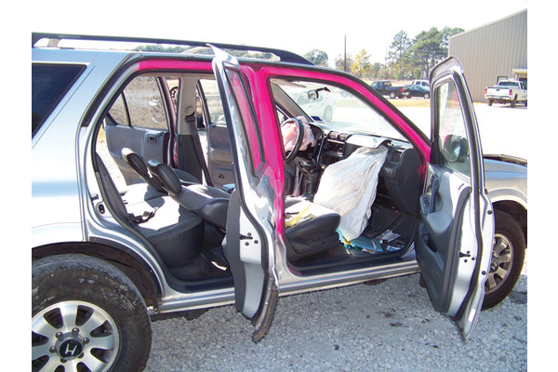

Slide 9
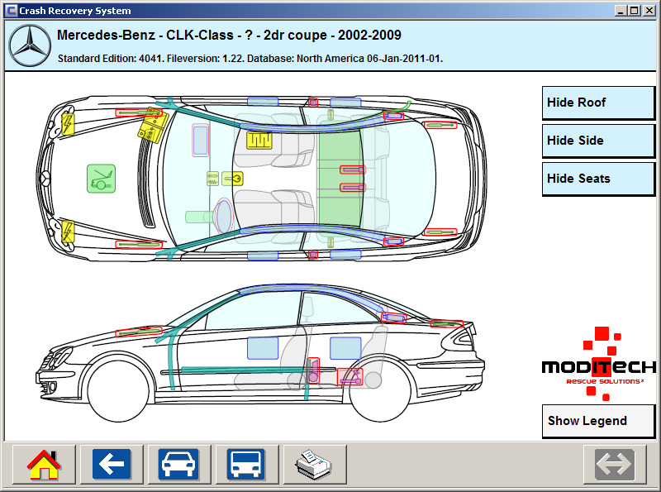
But where should you paint?

Slide 10
Top 10 Best selling Vehicles (2011)
Ford F-Series — 584,917 sales
Chevrolet Silverado — 415,130 sales
Toyota Camry — 308,510 sales
Nissan Altima — 268,981 sales
Ford Escape — 254,293 sales
Ford Fusion — 248,067 sales
Dodge Ram 1500/2500/3500 — 244,763 sales
Toyota Corolla — 240,259 sales
Honda Accord — 235,625 sales
Chevrolet Cruze — 231,732 sales

Slide 11
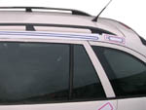
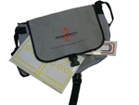
Moditech Magnet labels
Magnet labels displaying safety components. To be uses during training or extrication of victims from crashed vehicles.
Storage bag included.
2 x Battery.
4 x Sensor.
4 x Cylinder.
4 x Stored gas inflator.
1 x Curtain airbag left-hand side.
1 x Curtain airbag right-hand side.
1 x Seatbelt pretensioner.
1 x Seatbelt pretensioner (mirrored).
4 x Reinforcement.
Cost, over $300!

Slide 12
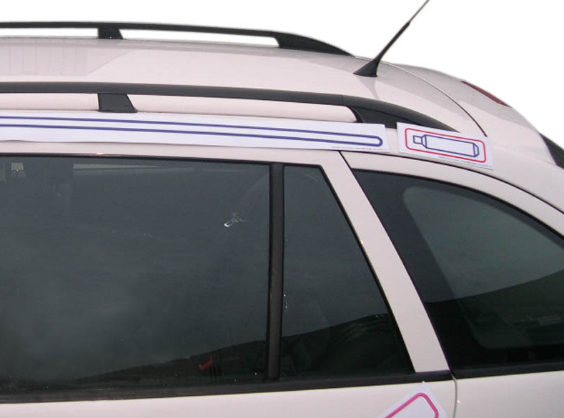
Moditech Magnet labels

Slide 13
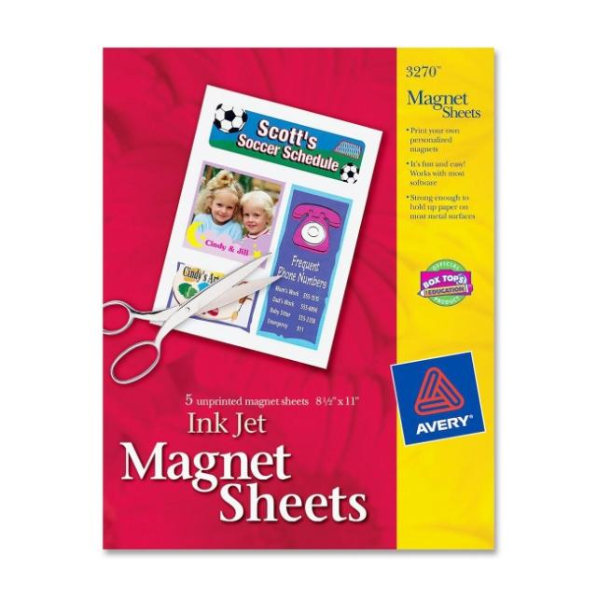
Printable Magnet Sheet
Battery
Sensor.
Cylinder.
Stored gas inflator.
Curtain airbag side.
Seatbelt pretensioner.
Reinforcement.

Slide 14
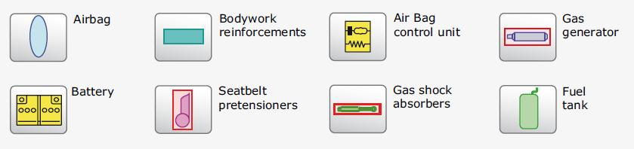
Printable Magnet Sheet
Cost of the printable magnets? Around $12 at an Staples or Office Max

Slide 15
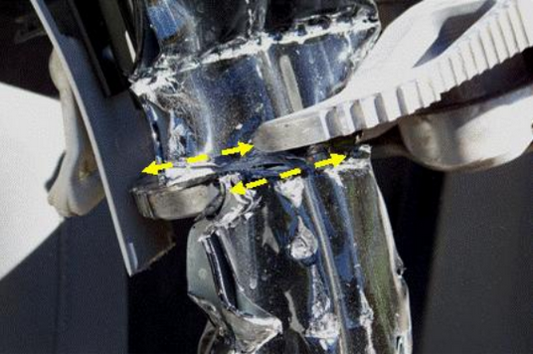
Simulated Tool Failure

Slide 16
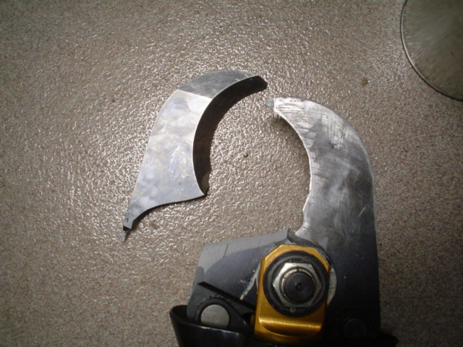
Blades can break
Notes:
On June 7, 2008 Station 52 and Squad 152 were dispatched to an MVA with entrapment. Upon arrival Chief 52, found a car on its side with the patient trapped inside the vehicle. Rescue 52 arrived and began extrication procedures. Our Hurst Extractor was deployed and the crew used it to begin cutting the roof. While cutting the B post The Extractor blade snapped. After snapping, the blade propelled through the air and struck one of our Squad members, on his back just above his hip. The member, also a firefighter, had no idea that he had been struck. The extrication was completed using our backup cutters. After the patient was removed from the vehicle Chief 52 noticed a large amount of blood on Firefighter-EMT's turnout coat. Upon removing the coat he found that the blood had soaked through the jumpsuit he had on as well. The Chief immediately called for the paramedics who exposed the wound to find an approximately 1 Â½ inches long by Â½ inch deep laceration. The Firefighter-EMT was transported to the University Medical Center of Princeton. His wound was confined to the muscle tissue and did not penetrate any vital organs. The laceration required multiple stitches and needed to have a drain installed. Everyone agrees that because Firefighter-EMT was wearing his appropriate gear he did not suffer more serious injuries.

Slide 17
Remember Hand Tools
Our students should not become over-reliant on their hydraulic tools.
Hydraulic pumps can fail
Cutter blades can break
Spreader arms can fracture
Without a back-up plan like hand tools rescuers can be dead in the water

Slide 18
Plan B
Vehicles that exit the road can often times can be further than hydraulic hoses can reach.
Rescuers commonly think about that while in route to the scene.
That Plan B and even Plan C can allow the rescuer to quickly shift to a different technique or tool.

Slide 19
Questions?

