Slide 1
Use of technology to stay informed
Mike Smith
BoronExtrication.com

Slide 2
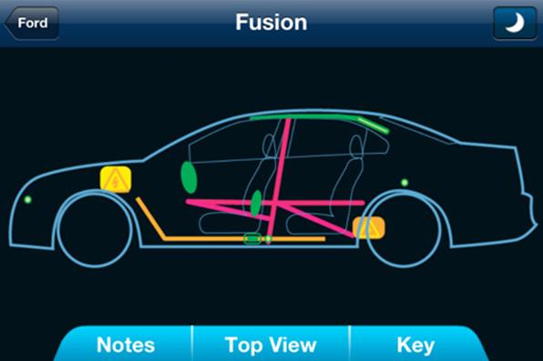
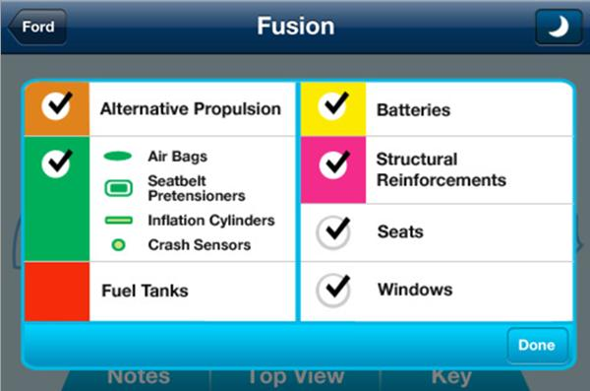
Extraction Zones

Slide 3
Hybrid Auto Extrication Guide
Field Applications, LLC, is a group effort. Their products are designed by firefighters and paramedics, graphic designers and software engineers. Cal Blake is the founder. He has worked as a first responder in California since 2006.

Slide 4
Crash Recovery System
Moditech Rescue Solutions B.V. designed the Crash Recovery System (CRS) 10 years ago to solve this controversy between safety and accessibility. Now the CRS made its way to the iOS platform. With the iCRS app, rescue relevant technical vehicle information in regards to restraint systems, reinforcements, propulsion systems are available at your fingertipsSpecially developed for emergency responders, iCRS provides an invaluable source of information. After selection of the right model from the comprehensive database, iCRS shows an interactive top and side view of the vehicle, indicating the exact location of rescue relevant equipment in various color schemes. Additional information can be displayed to indicate how to safely disable these systems during rescue operations.
Know whatʼs inside! iCRS enables emergency resonders to:
  Access a comprehensive database including all airbag equipped passenger cars available in North-America.
  Latest technology included (hybrid, electric and fuel cell vehicles, new airbag technologies and advanced steel reinforcements).
  Quick and easy access to all rescue relevant vehicle information.
  Access deactivation information to disable the propulsion and restraint systems within seconds.
  Base extrication plans on the actual vehicle equipment to save valuable time.
  Database updates available every other week.

Slide 5
West Virginia University Research Corporation/NAFTC
This first responder quick reference guide, developed by the National Alternative Fuels Training Consortium (NAFTC), is a tool for emergency personnel who need to access information about alternative fuel and advanced technology vehicles at an accident scene. This app contains information on advanced technology vehicles such as hybrid, plug-in hybrid, battery, and fuel cell electric vehicles, as well as vehicles powered by alternative fuels such as biodiesel, ethanol, natural gas, propane, and hydrogen. You will find detailed, vehicle-specific information including identification mechanisms, disconnect procedures, and other special concerns. Although similar, each vehicle has distinct differences that make it unique, and first responders need to know and understand these differences. The NAFTC understands the hazards that alternative fuel and advanced technology vehicles could pose to emergency personnel, and this app, along with our entire suite of First Responder Safety Training products, provides first responders with the information needed to safely respond to an accident involving one of these vehicles. This app can be used on both the iPhone and the iPad.

Slide 6
Opel Rescue Cards
Opel is placing the information for some 60 models from 1991 to present on a mobile portal that can be used on any smartphone which has access to the Internet. This free mobile service is available in 10 European languages[1] and enables rescue crews to access important information instantly. An eleventh language, Turkish, will follow shortly.

Slide 7
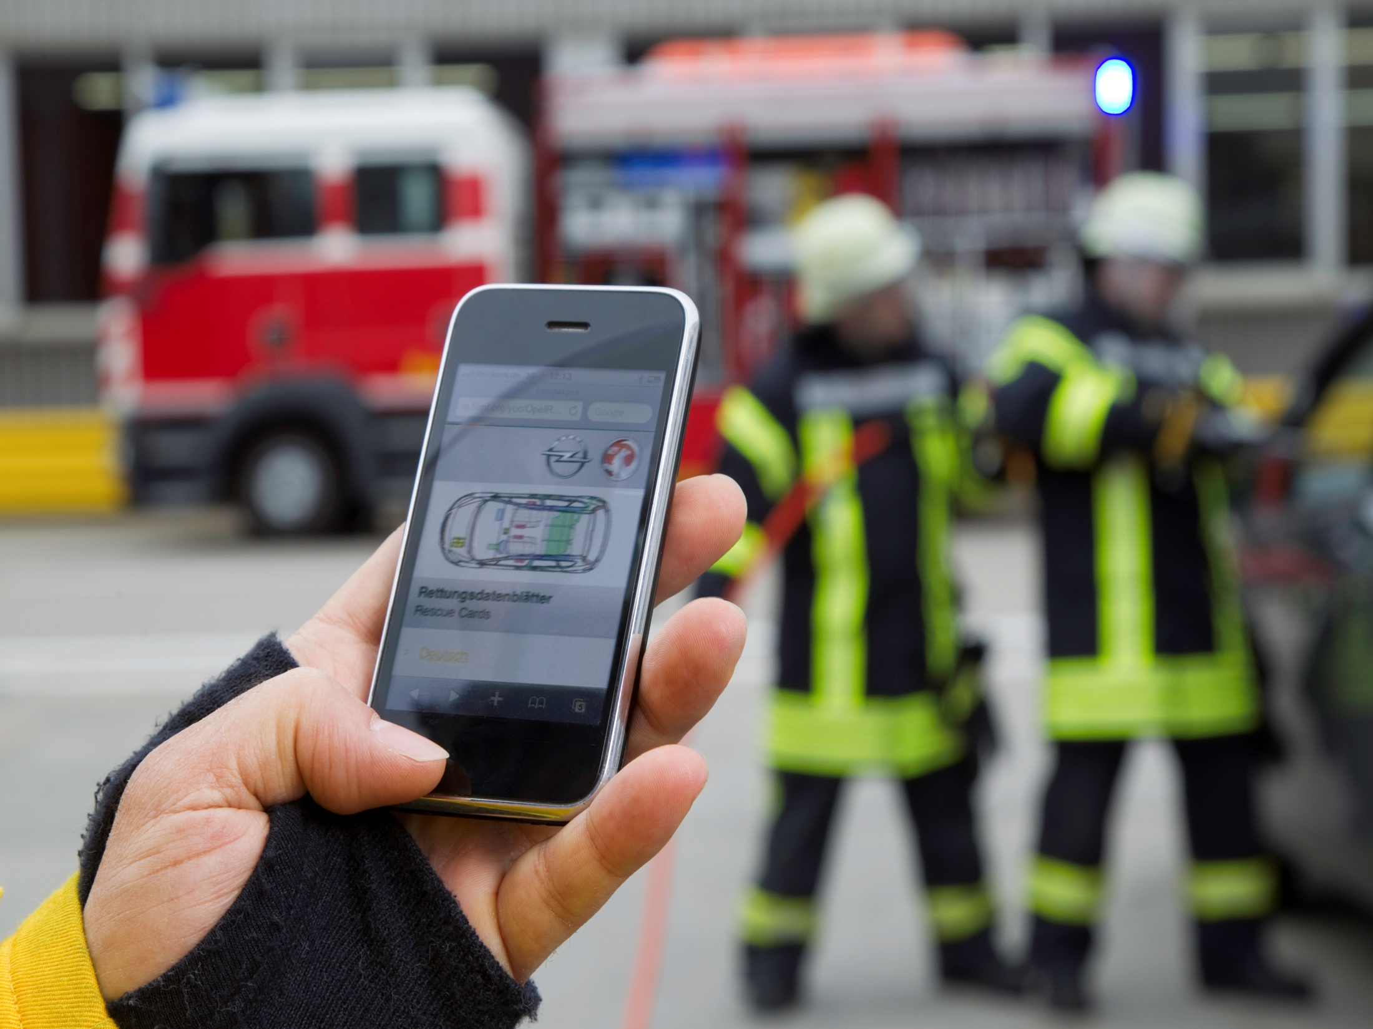

Slide 8
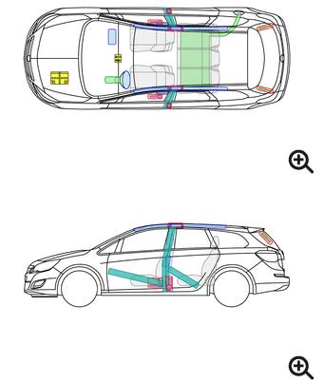
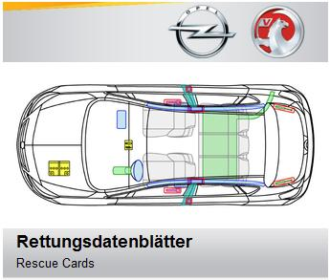

Opel Rescue Cards

Slide 9
Newletters

Slide 10
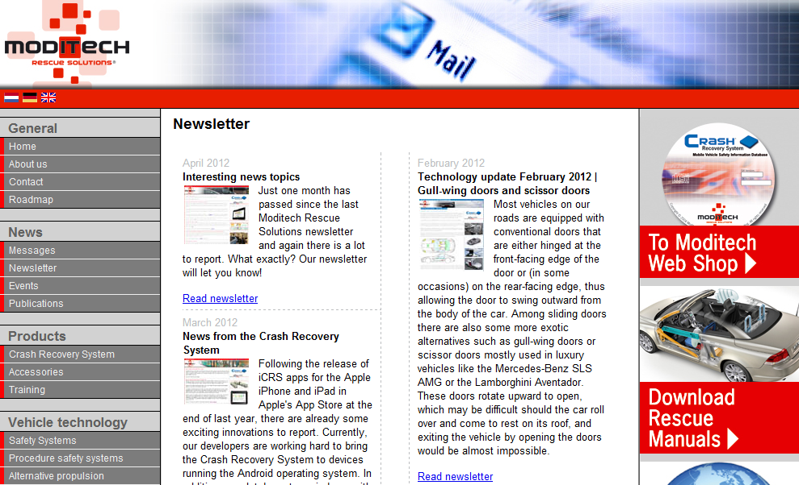
Moditech Newsletter

Slide 11
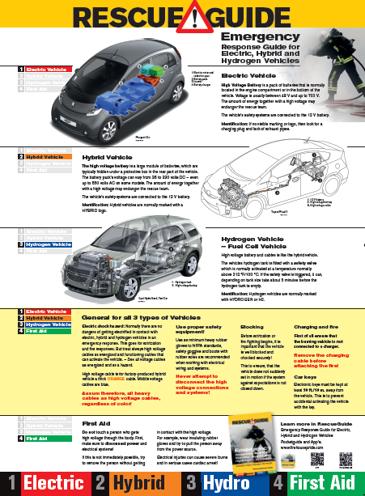
Rescue Guide Booklet

Slide 12
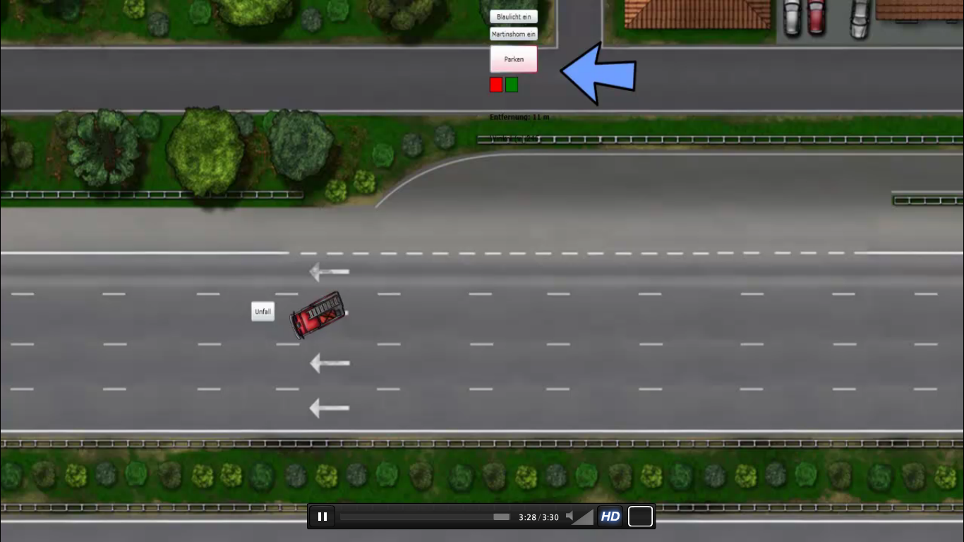
Weber Rescue
Rescue Team Leader Game

Slide 13
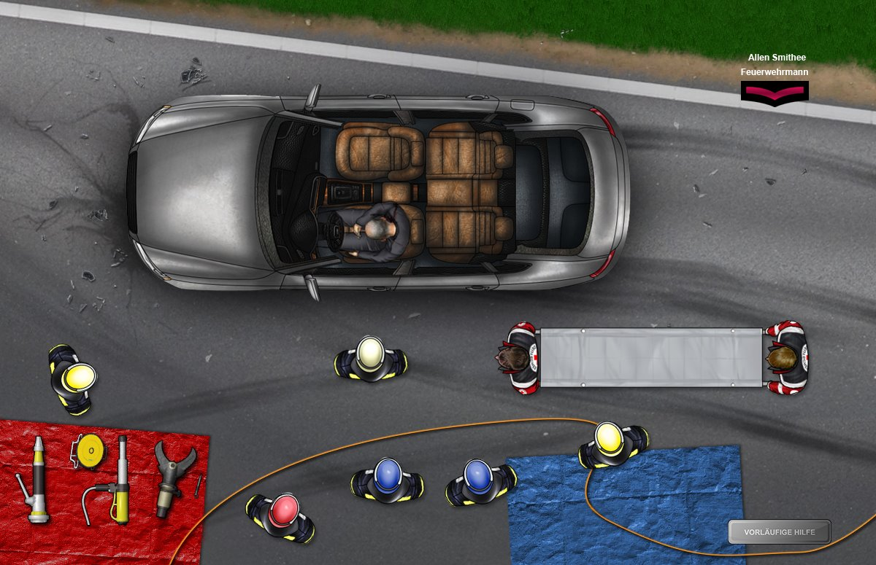
Weber Rescue
Rescue Team Leader Game

Slide 14
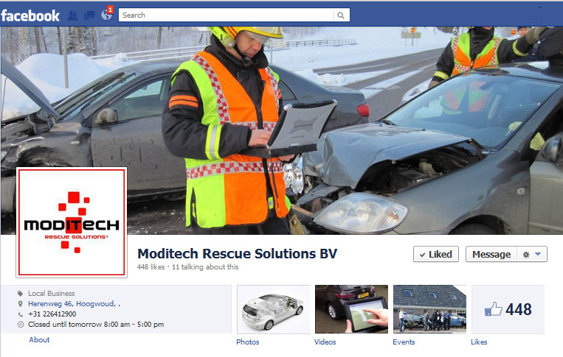
Facebook Pages

Slide 15
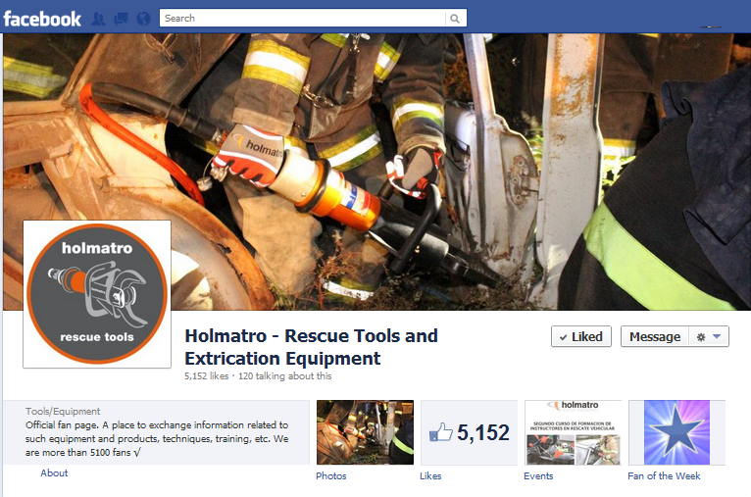

Slide 16
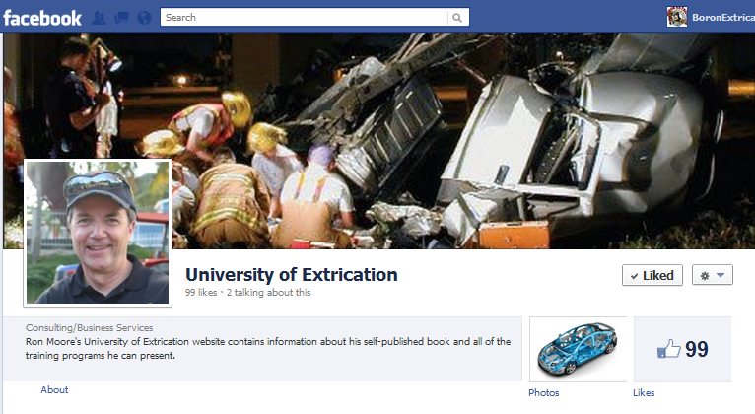

Slide 17
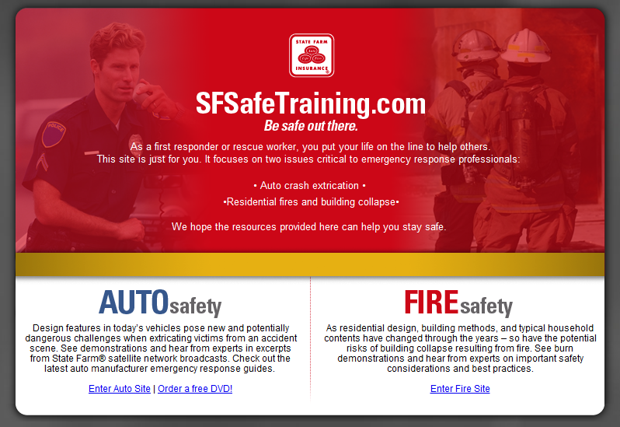
Free Training Material

Slide 18
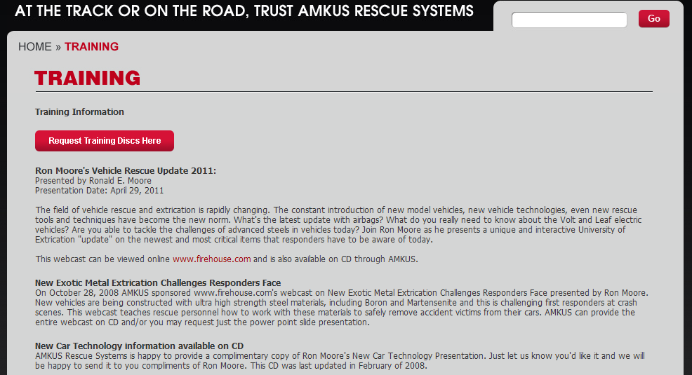
Ron Moore's Vehicle Rescue Update 2011

Slide 19
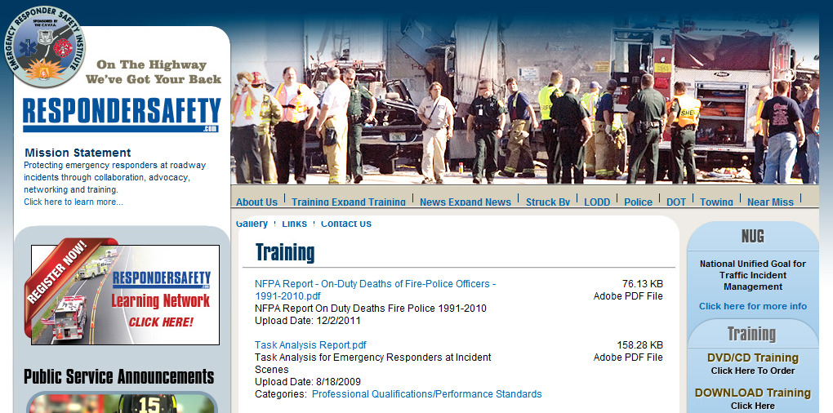
Emergency Responder Safety Institute

Slide 20
Questions?

